Slide 1
Recording
Finance Readiness
Common Military Training

Slide 2
Historical Information
NDAA FY16 requires that Soldiers take specific financial readiness training based on personal and professional milestones throughout their career.
Prepare Finances for a Permanent Change of Station (PCS): G09-COM-0002
Prepare Finances for a Deployment: G09-COM-0003
Prepare Finances for a Return from Deployment: G09-COM-0004
Prepare Finances for Vesting in the Thrift Savings Plan: G09-COM-0005
Prepare Finances for Continuation Pay Under Blended Retirement System: G09-COM-0006
Prepare Finances for Marriage: G09-COM-0007
Prepare Finances for a Divorce: G09-COM-0008
Prepare Finances for Welcoming a New Child: G09-COM-0009
Prepare Finances for a Disabling Sickness or Condition and enrollment into the Exceptional Family Member Program: G09-COM-0010
Prepare Finances for a Promotion: G09-COM-0011

Slide 3
Recording Training Using Wizard
Recording Finance Readiness Training
(Wizard)

Slide 4
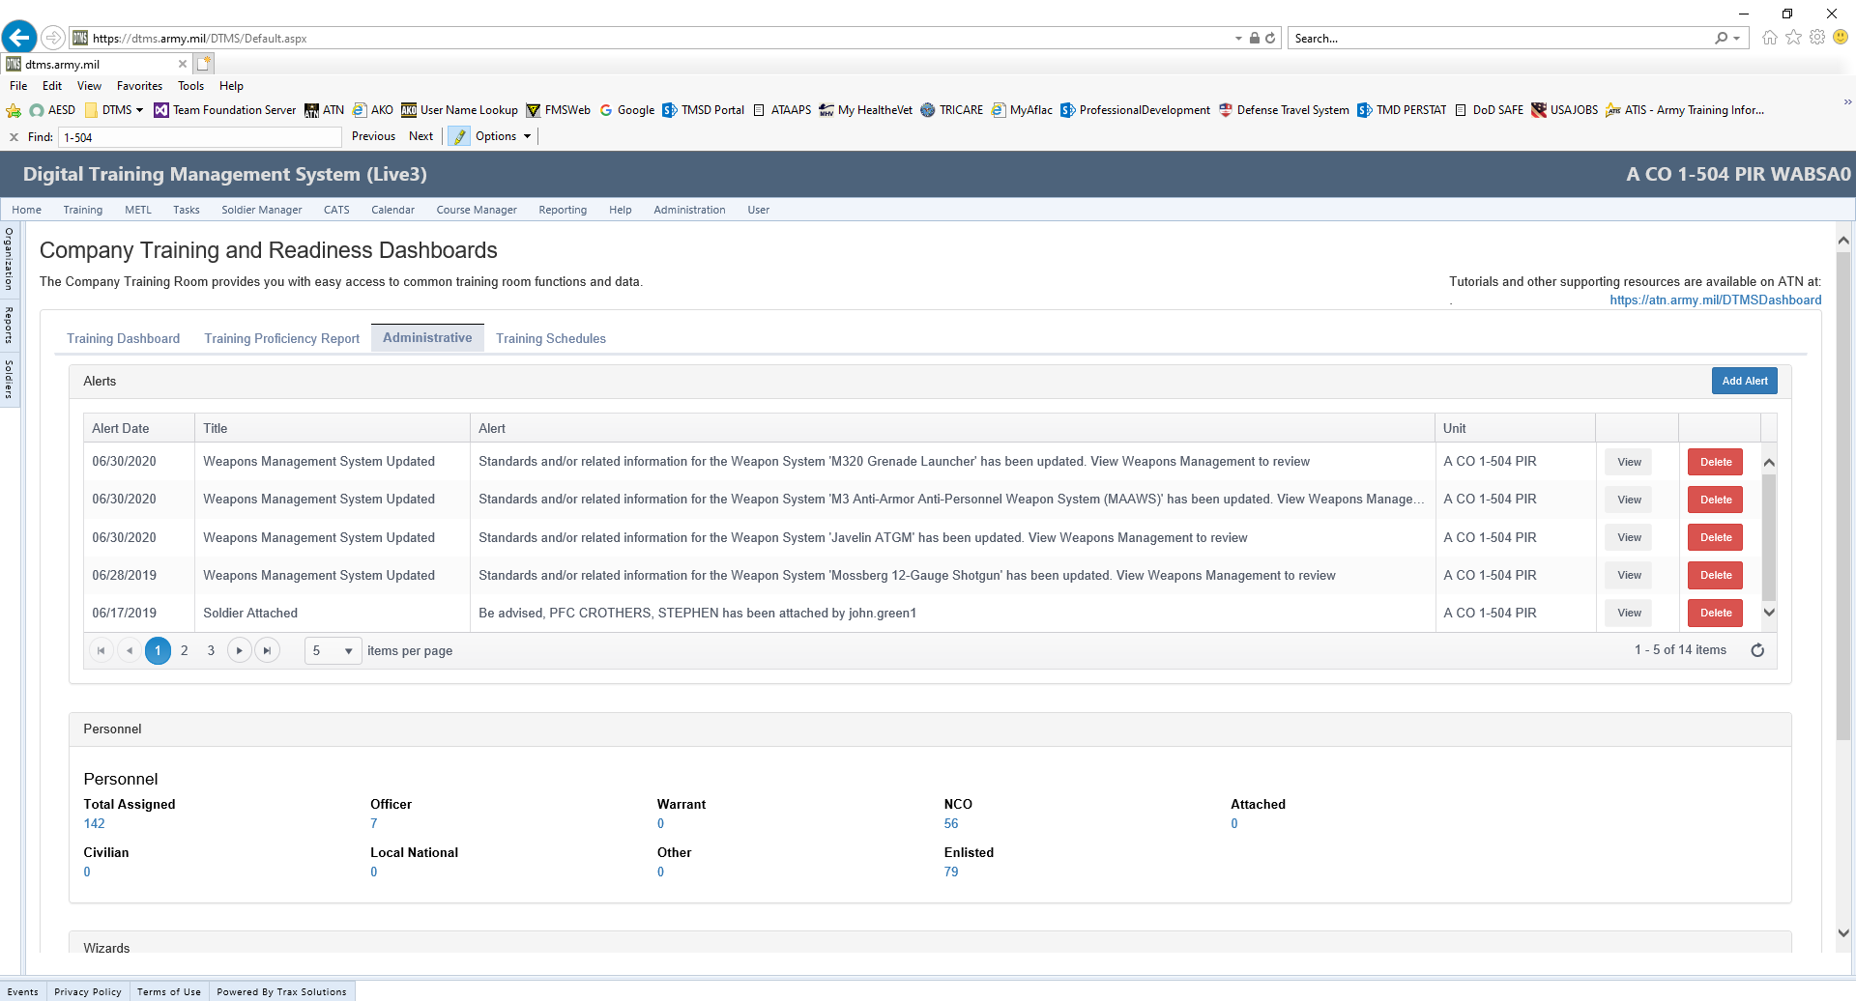
Dashboard
Select Administrative

Slide 5
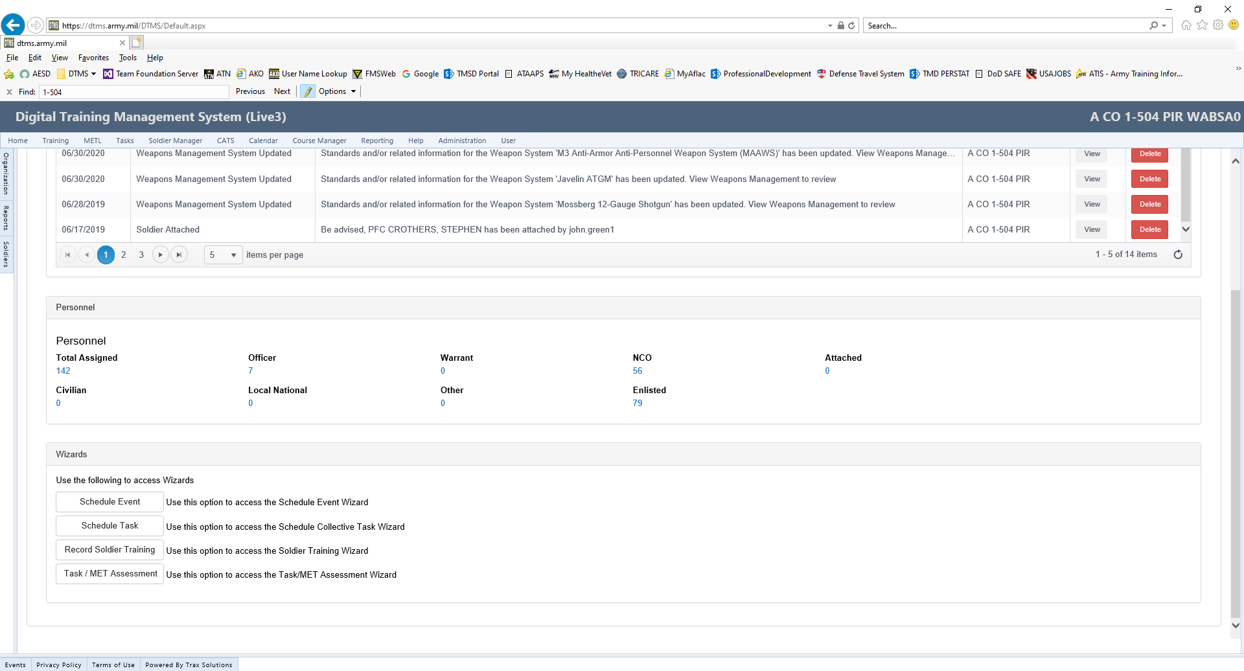
Record Soldier Training
Select “Record Soldier Training”

Slide 6
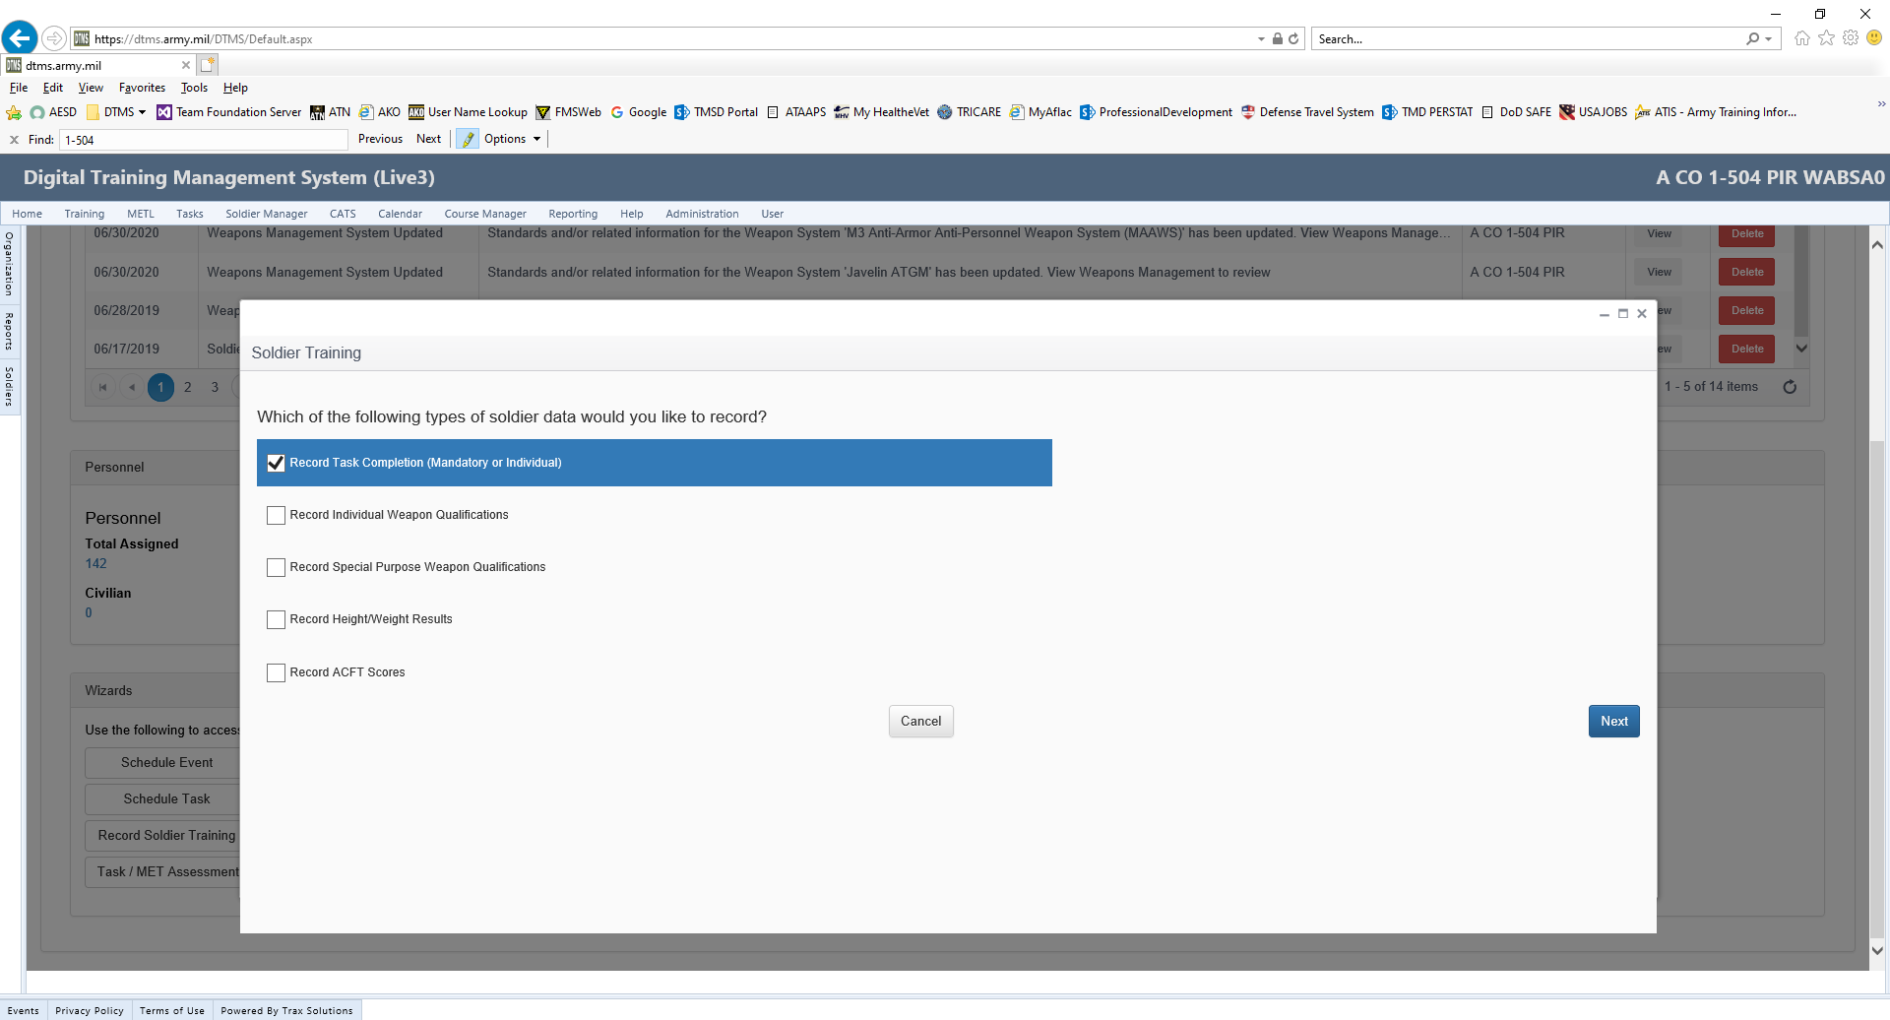
Record Task Completion
Select “Record Task Completion” (Mandatory or Individual)
Select “Next”

Slide 7
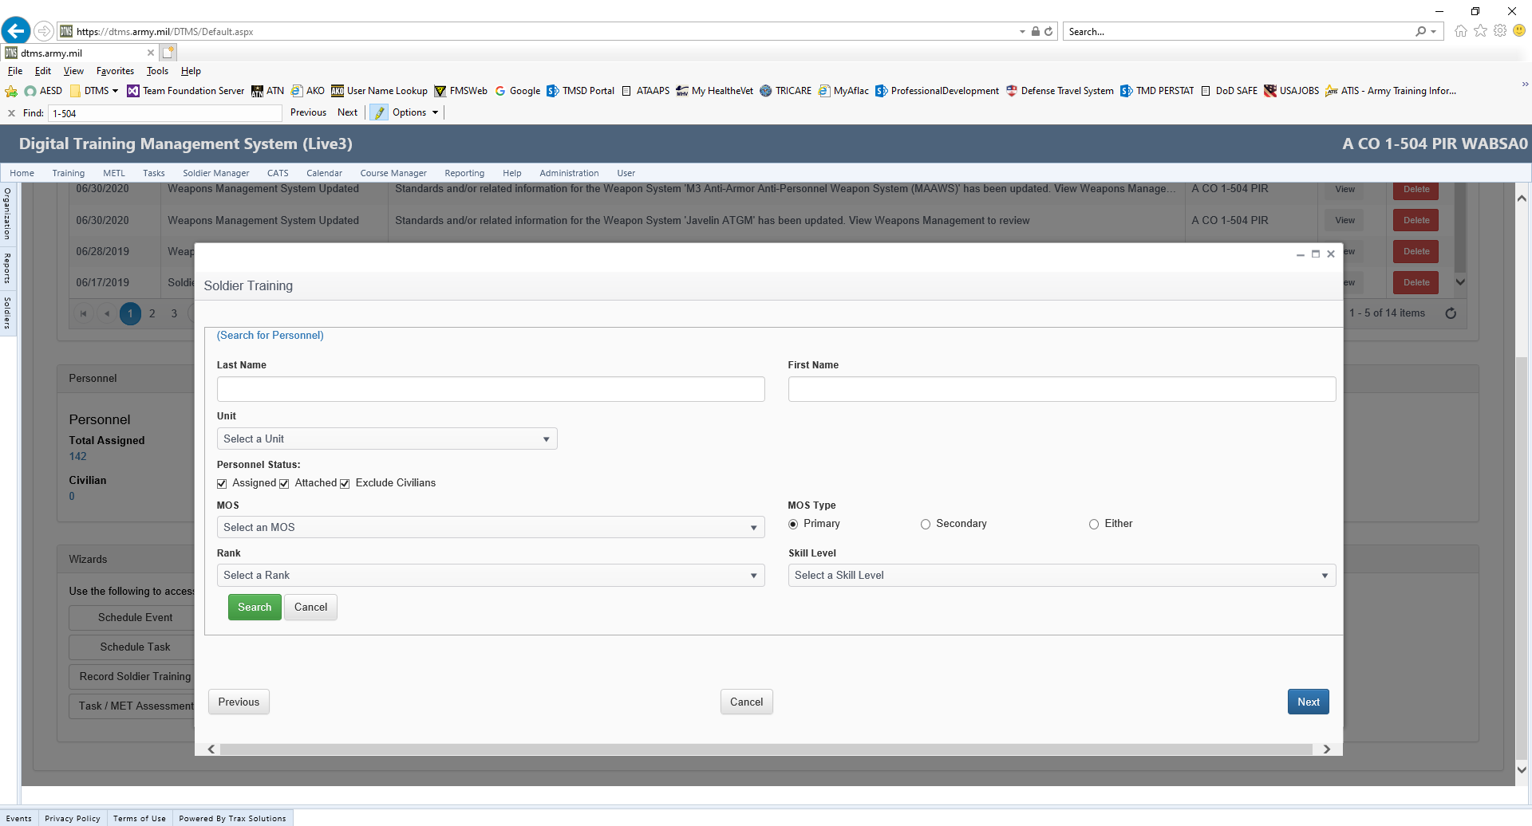
Generate Roster
Select “Search” to generate a roster of unit personnel.

Slide 8
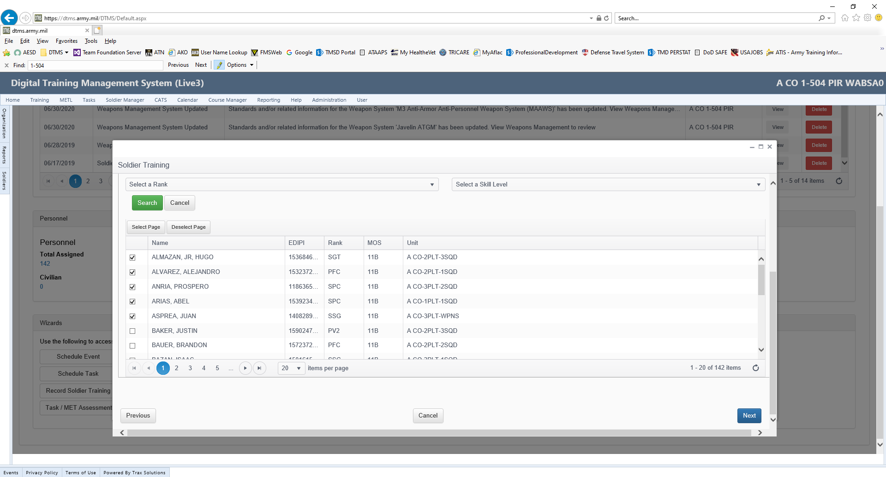
Select Soldiers
Select the Soldiers that took the training.
Once all Soldiers have been selected, Click on the “Next” tab

Slide 9
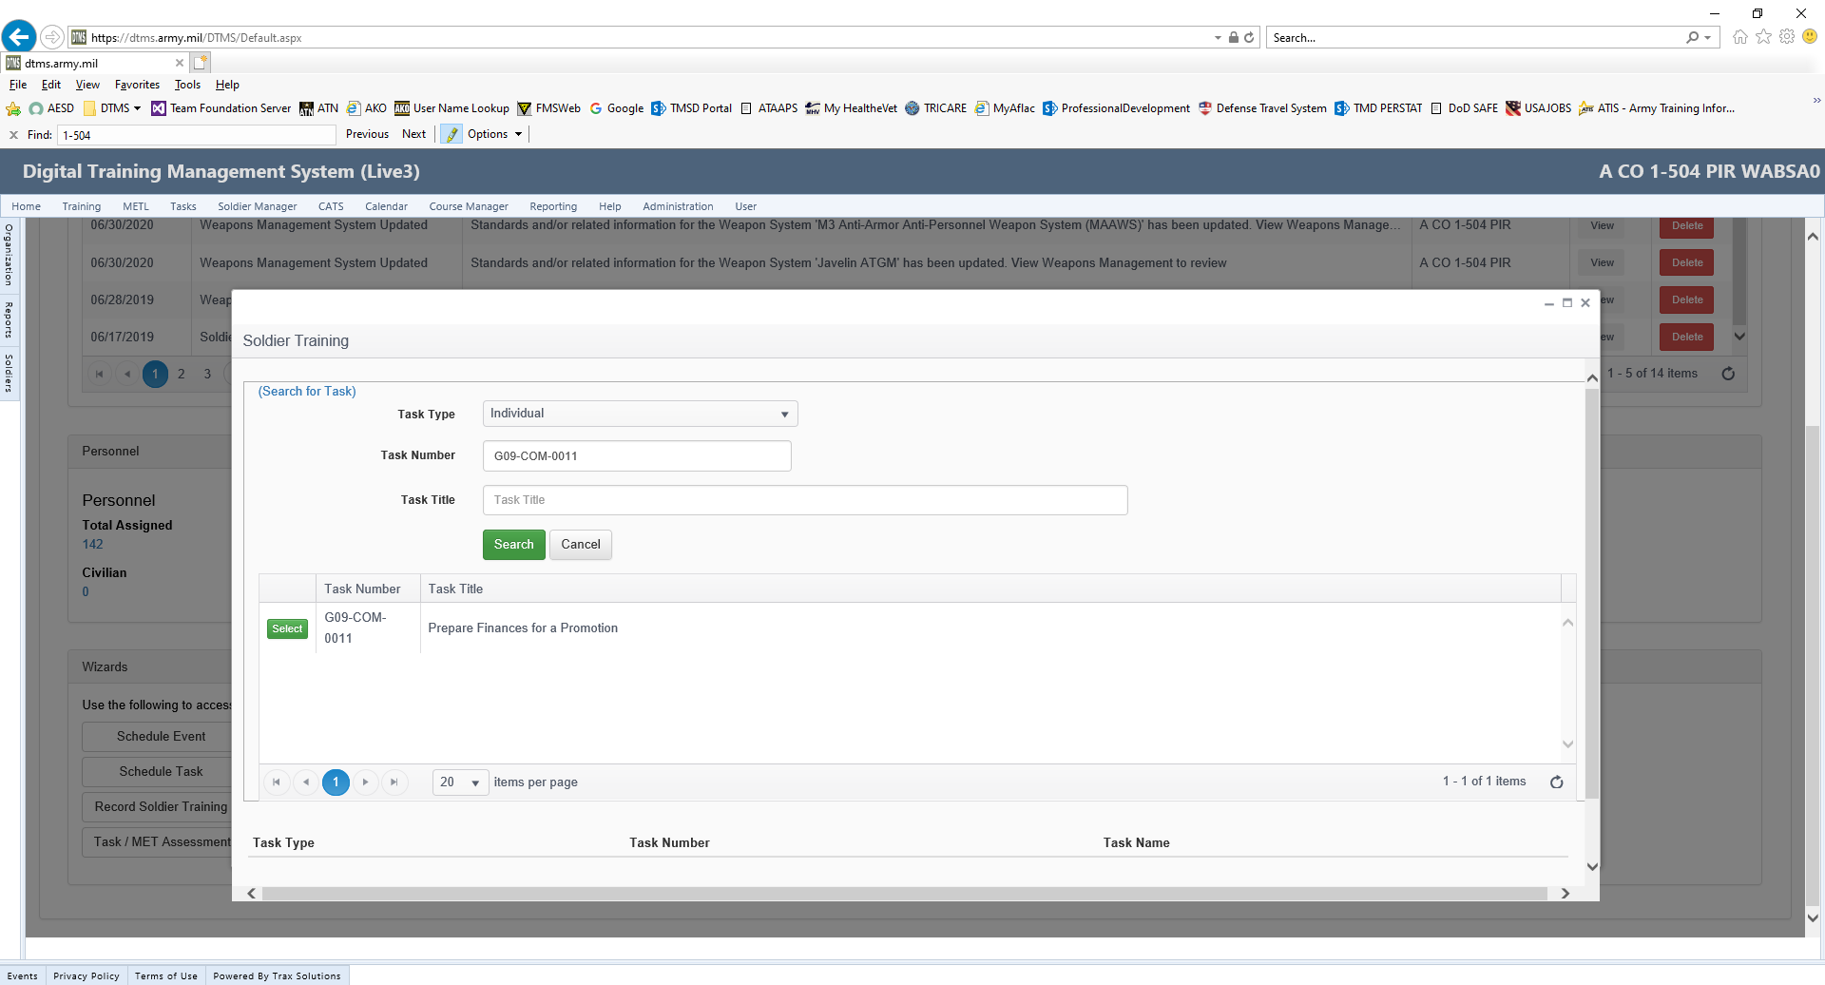
Task Number
Put in the Task Number and click the “Search Tab”. The task will generate below
Once the task has generated, click on the “Select Tab” followed by the “Next Tab” at the bottom right of the page.

Slide 10
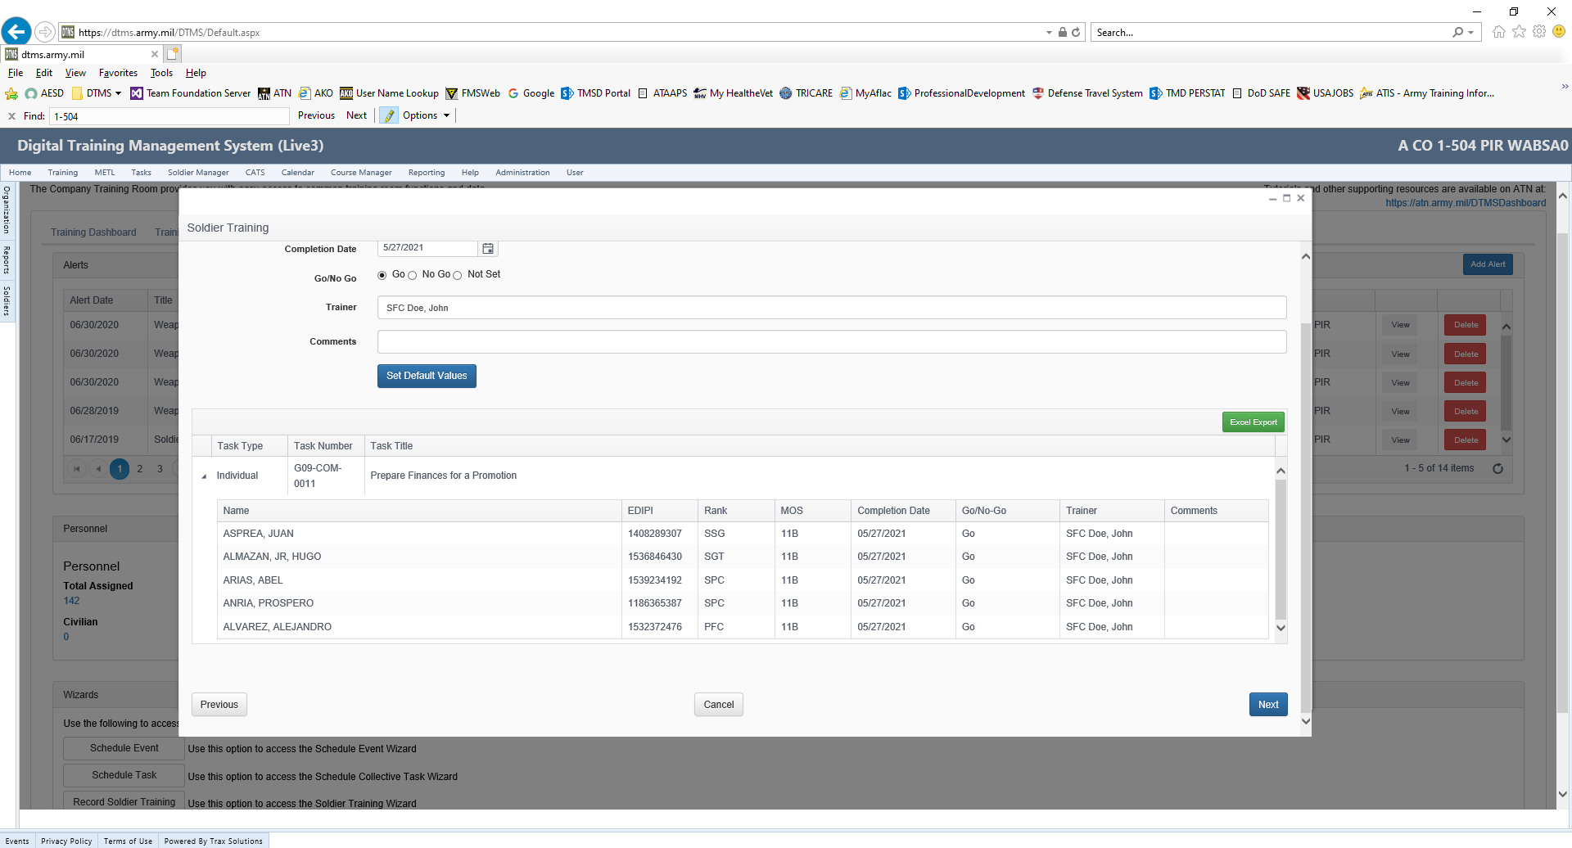
Add Date
Add in the “Date” of the Training, Go/NoGo and the name of the trainer and then select “Set Default Values”.
Once Default Values are set, the roster will be linked with the training conducted. Once this is updated select the “Next Tab”.

Slide 11
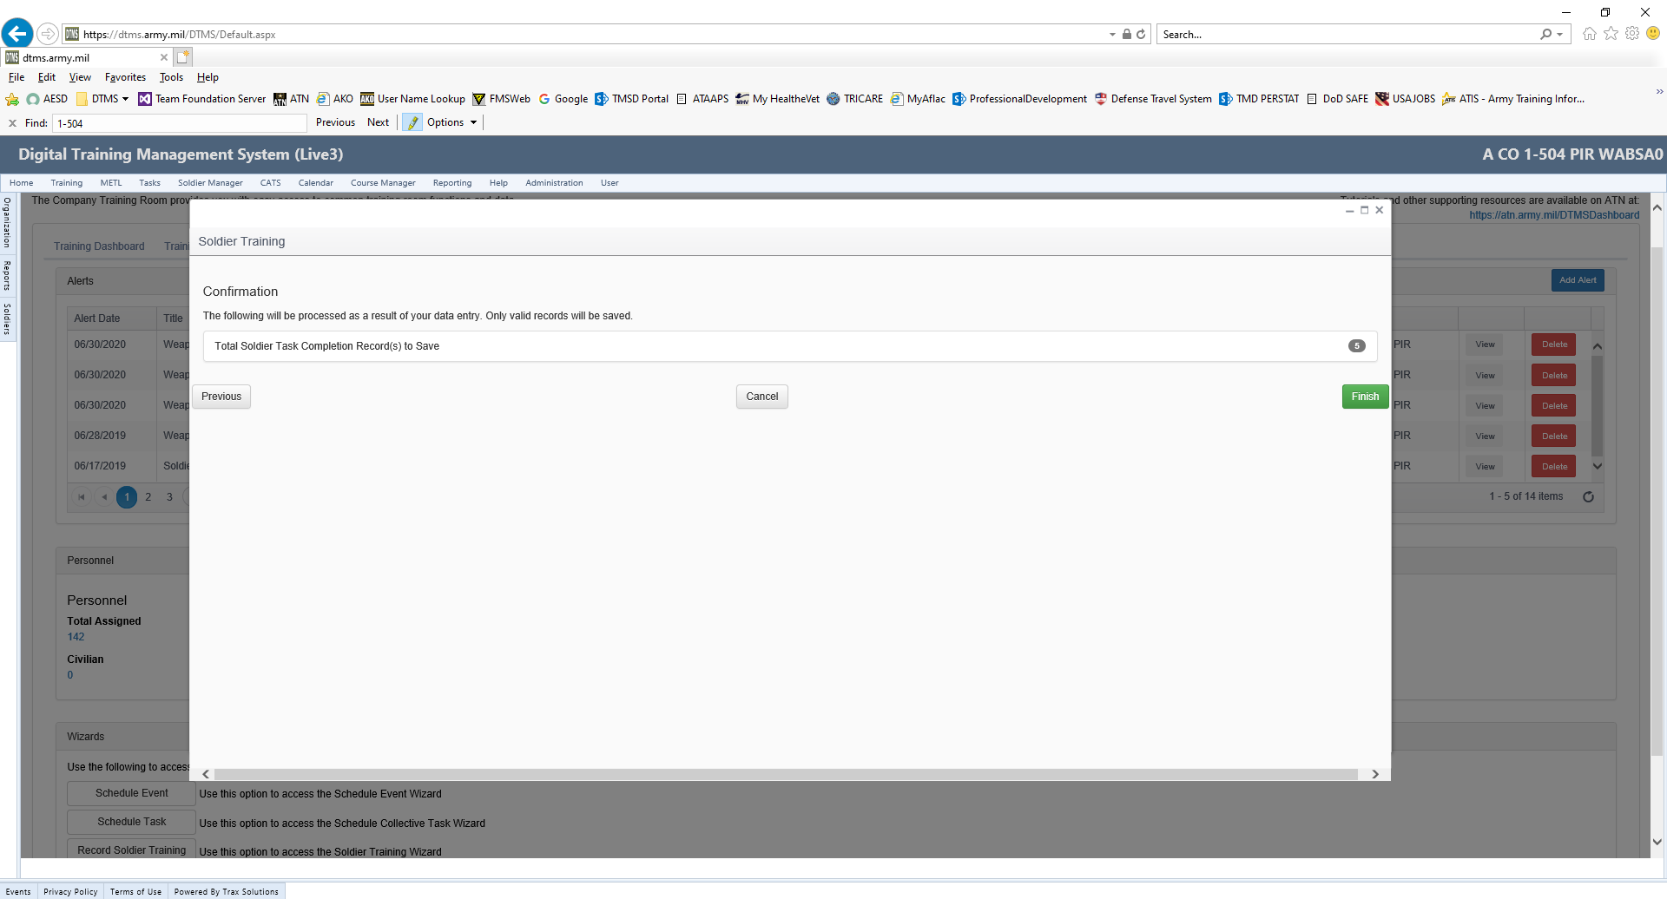
Confirmation Page
The Confirmation page will show how many records were updated. To complete the update, select the “Finish Tab”.

Slide 12
Recording Training in SULT
Recording Financial Readiness Training
(Small Unit Leaders Tool (SULT))

Slide 13
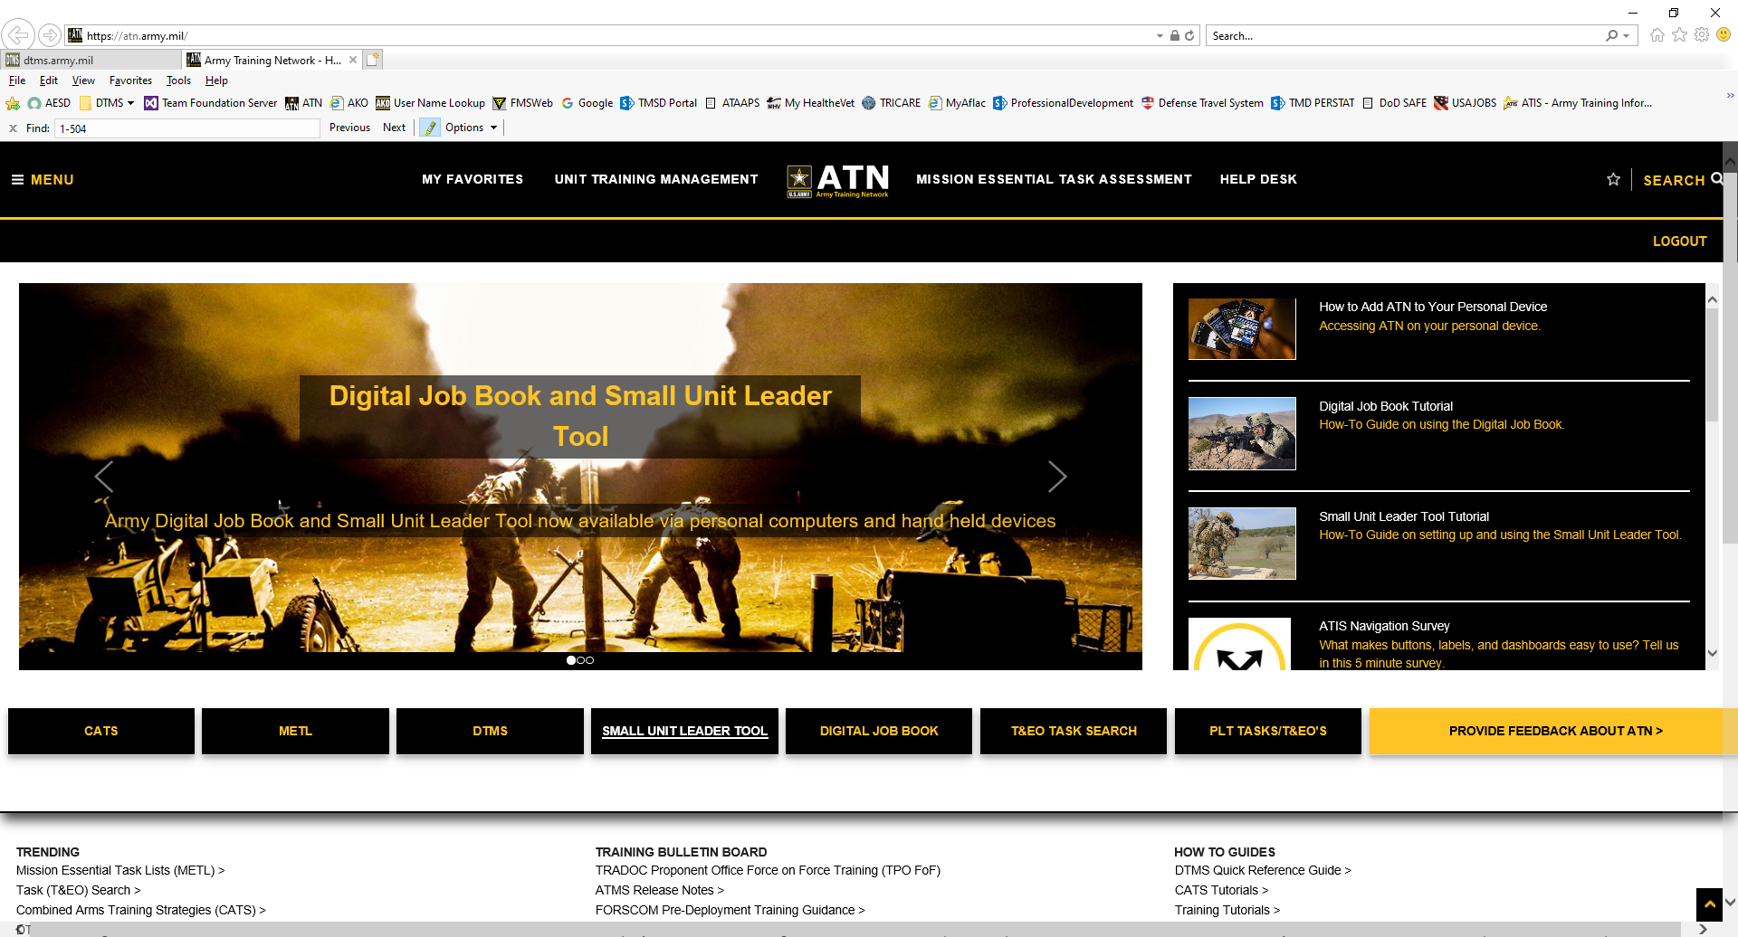
SULT Tool
Log into ATN and select the tab for the “Small Unit Leader Tool (SULT)”

Slide 14
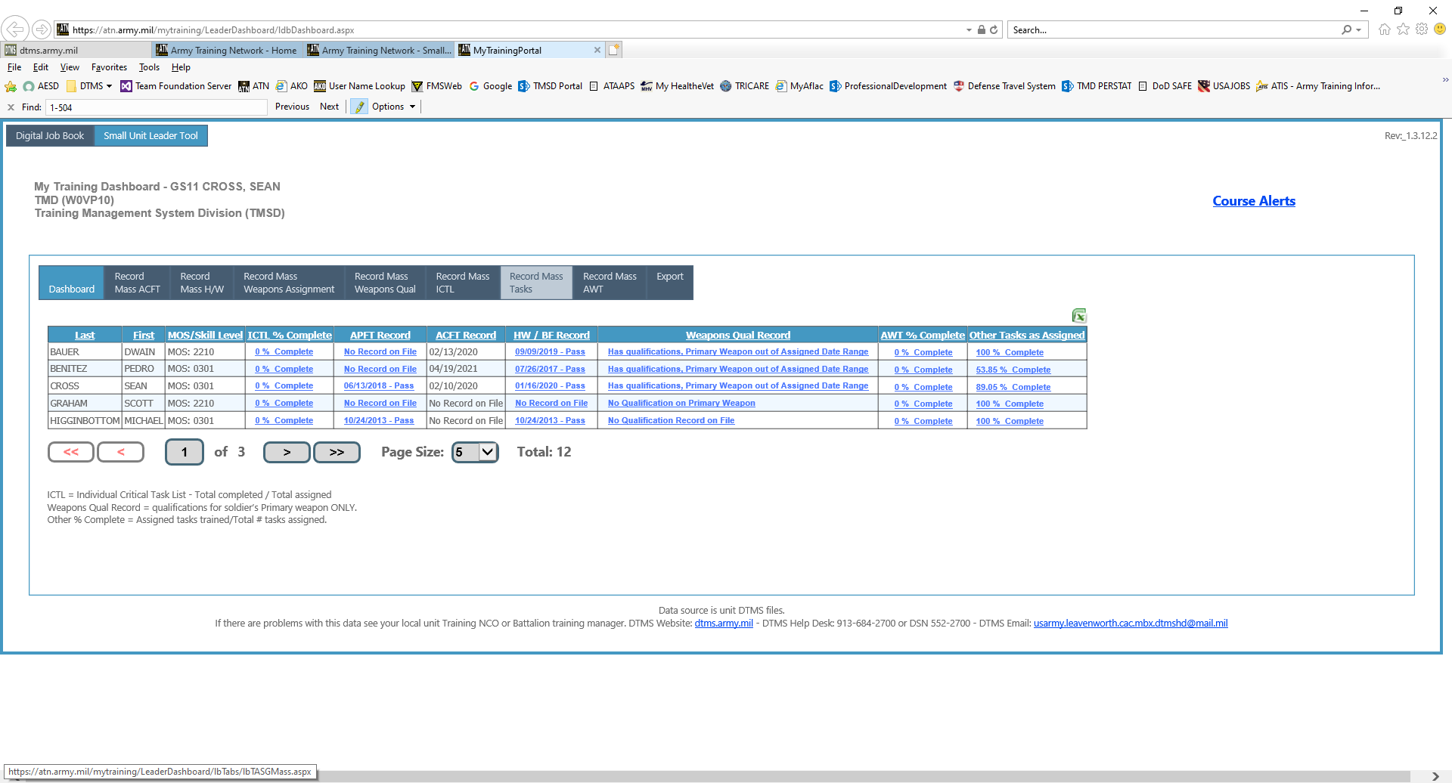
Record Mass Tasks
Select “Record Mass Tasks”

Slide 15
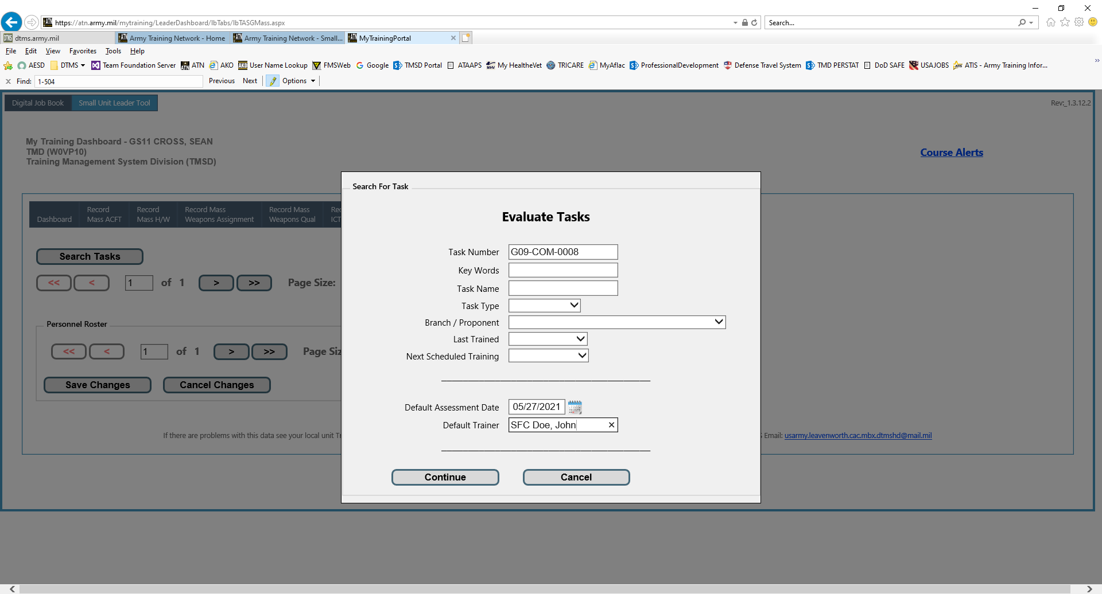
Evaluate Tasks
Enter the following:
Task Number
Date of the Training
Name of the Trainer
Select “Continue”

Slide 16
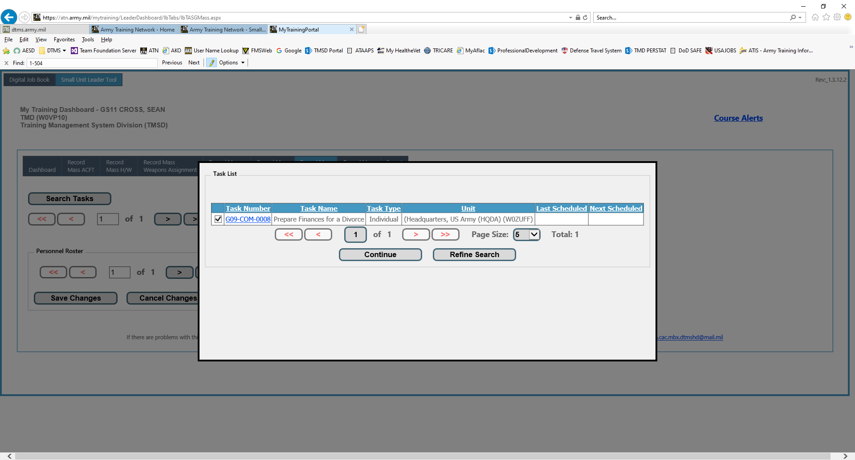
Verify Task
Verify the task to be trained by putting a check beside it and then select “Continue

Slide 17
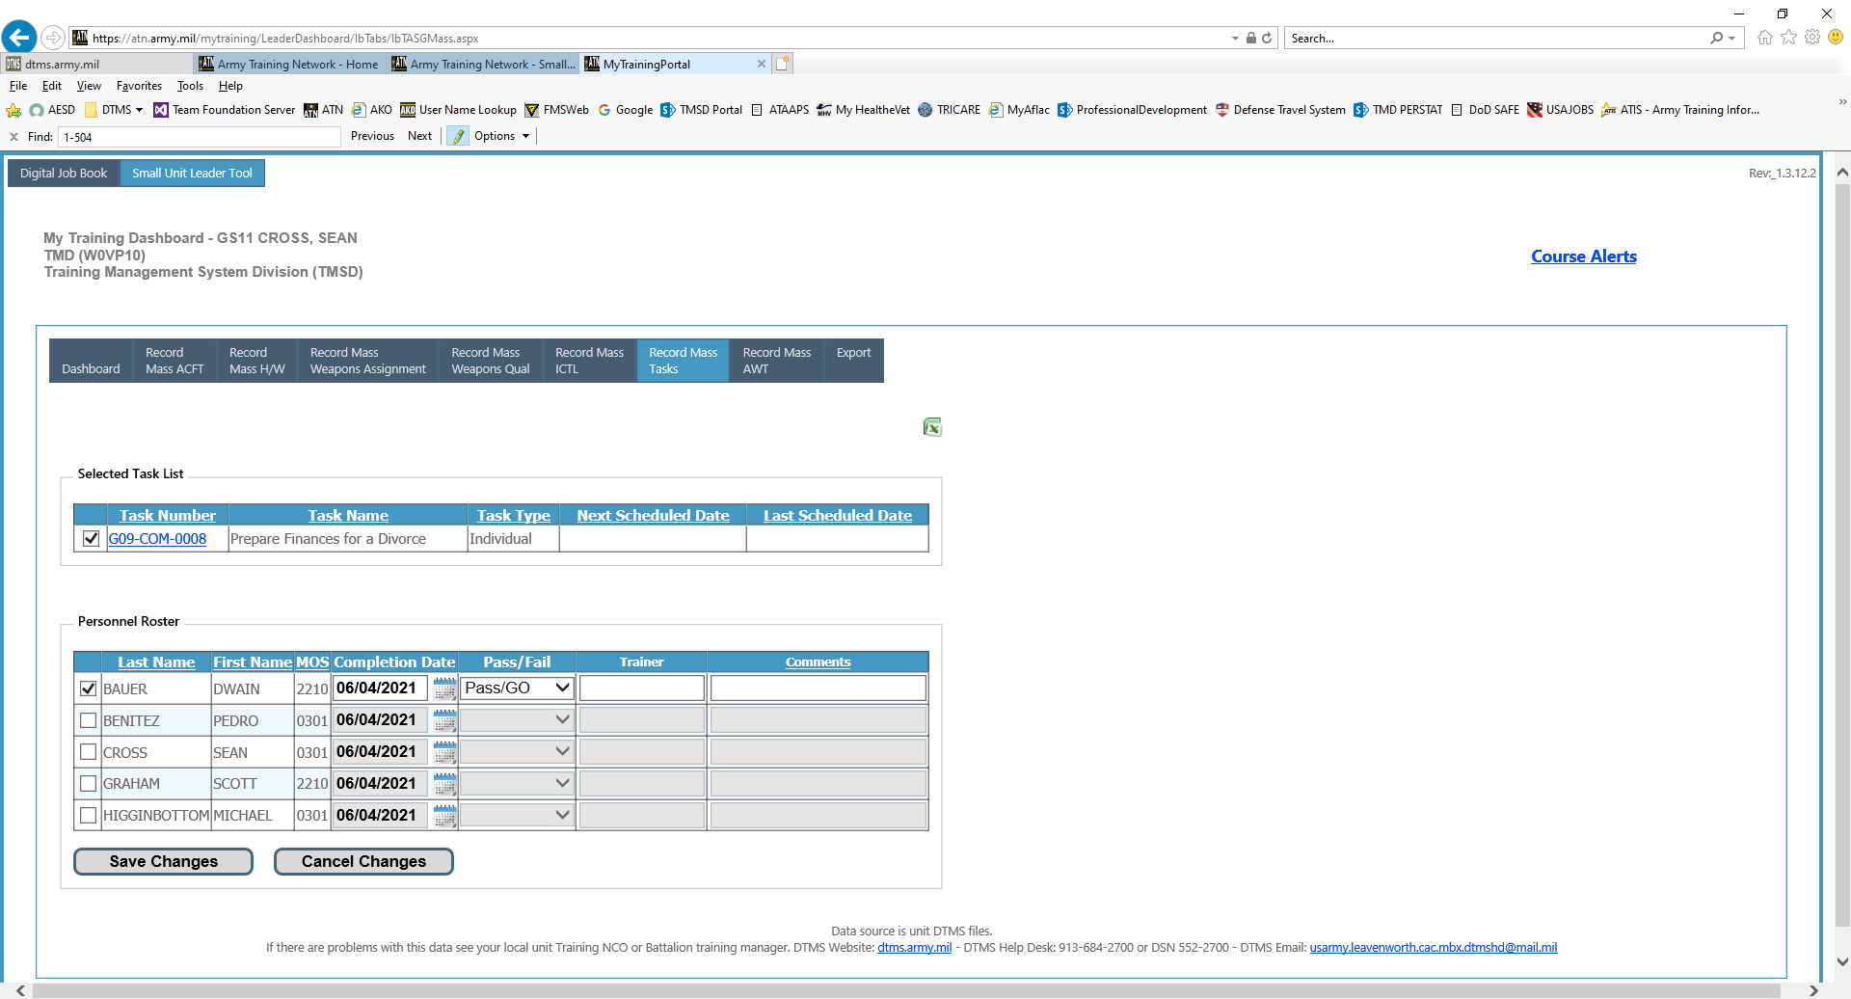
Save Changes
Put a check beside the task that has been trained.
Select the personnel that attended the training.
User the Drop Down for “Pass/Fail” to mark the “Go/NoGo”
Select “Save Changes “ to update the training for the Soldiers

Slide 18
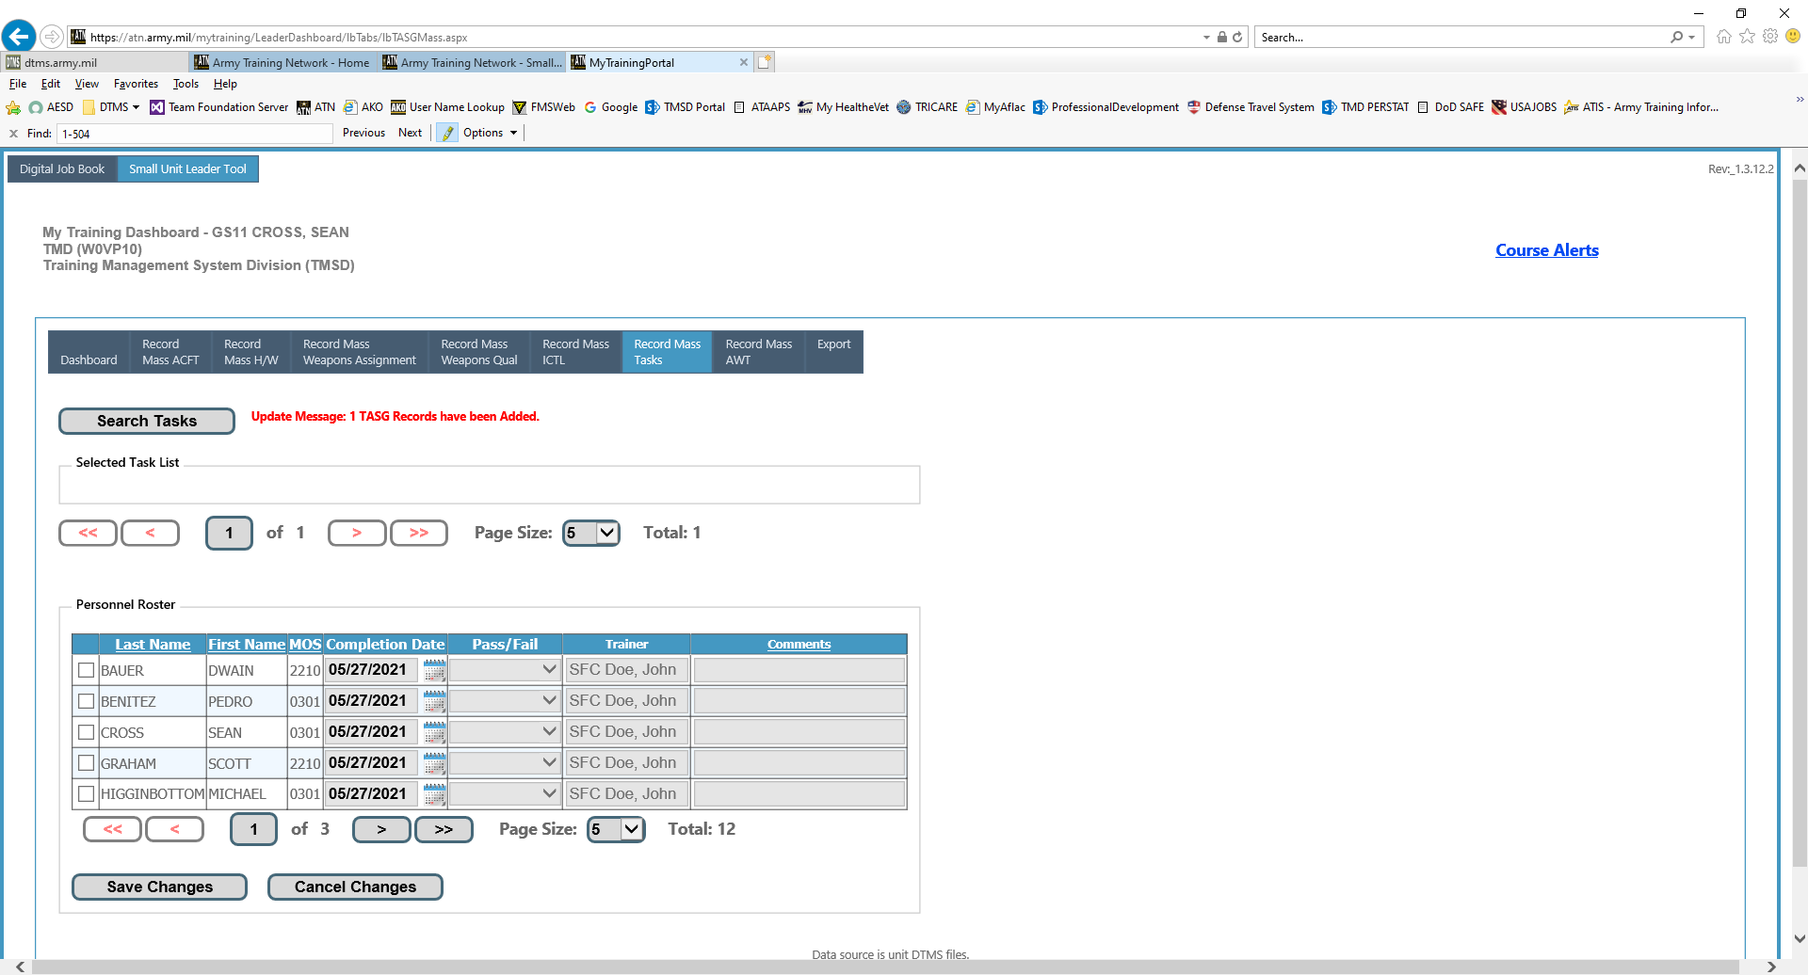
Number of Records
This message will show how many records were updated and transferred to DTMS and the Soldiers ITR.

Slide 19
Other Entry Options to Record Training
Individual Training Record: Training can be recorded in the “Job Book Tab” for updating one Solder at a time.
Scheduled Event: Training can be recorded for many tasks and several Soldiers at one time. Tasks must be added to the Scheduled Event and a Roster of all Soldiers that took part in the training must be added also.

